Slide 1
COMPUTER ORGANIZATION
Subcode:18CS34
Text books:
1 . Carl Hamacher, ZvonkoVranesic, SafwatZaky: Computer Organization, 5th Edition, Tata McGraw Hill, 2002.
Reference Books:
1. William Stallings: Computer Organization & Architecture, 9th Edition, Pearson, 2015.

Slide 2
COMPUTER ORGANIZATION
Course objectives: This course will enable students to
Understand the basics of computer organization: structure and operation of computers and their peripherals.
Understand the concepts of programs as sequences or machine instructions.
Expose different ways of communicating with I/O devices and standard I/O interfaces.
Describe hierarchical memory systems including cache memories and virtual memory.
Describe arithmetic and logical operations with integer and floating-point operands.
Understand basic processing unit and organization of simple processor, concept of pipelining and other large computing systems

Slide 3
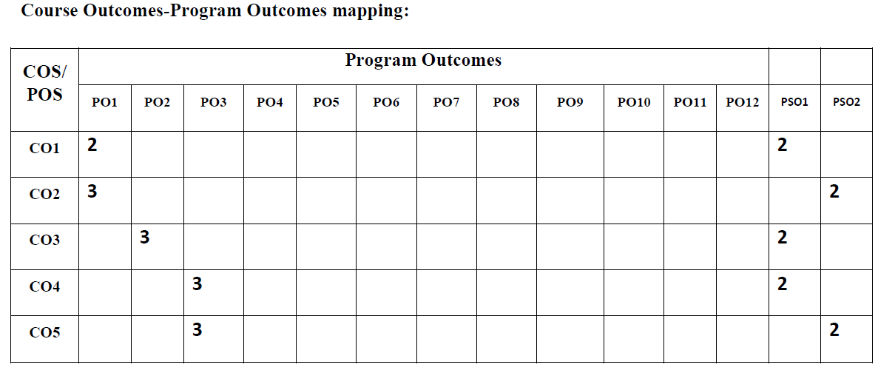
COMPUTER ORGANIZATION
Course Outcomes
CO1: Acquire the knowledge of basic concepts of computer organization.
CO2: Apply the concepts of booths algorithms and division algorithms to solve multiplication and division problems
CO3: Analyze the basic organization of memory, it's hierarchy, design and working.
CO4: Create simple assembly language subroutines for demonstrating interaction of of different sub systems such as processor, Input/output and Memory
CO5: Develop assembly language programs to demonstrate instruction execution through different instruction cycles.

Slide 4
Module – 1
Basic Structure of Computers: Basic Operational Concepts, Bus Structures, Performance –Processor Clock, Basic Performance Equation, Clock Rate, Performance Measurement.
Machine Instructions and Programs: Memory Location and Addresses, Memory Operations, Instructions and Instruction Sequencing, Addressing Modes, Assembly Language, Basic Input and Output Operations, Stacks and Queues, Subroutines, Additional Instructions, Encoding of Machine Instructions

Slide 5
Module – 2
Input/Output Organization: Accessing I/O Devices, Interrupts – Interrupt Hardware, Direct Memory Access, Buses, Interface Circuits, Standard I/O Interfaces – PCI Bus, SCSI Bus, USB.

Slide 6
Module – 3
Memory System: Basic Concepts, Semiconductor RAM Memories, Read Only Memories, Speed, Size, and Cost, Cache Memories – Mapping Functions, Replacement Algorithms, Performance Considerations

Slide 7
Module – 4
Arithmetic: Numbers, Arithmetic Operations and Characters, Addition and Subtraction of Signed Numbers, Design of Fast Adders, Multiplication of Positive Numbers, Signed Operand Multiplication, Fast Multiplication, Integer Division.

Slide 8
Module – 5
Basic Processing Unit: Some Fundamental Concepts, Execution of a Complete Instruction, Multiple Bus Organization, Hard-wired Control, Micro programmed Control.
Pipelining: Basic concepts of pipelining

Slide 9
What is a computer?
A computer is a fast electronic calculating machine that:
Accepts input information,
Processes the information according to a list of internally stored instructions and
Produces the resulting output information.
Functions performed by a computer are:
Accepting information to be processed as input.
Storing a list of instructions to process the information.
Processing the information according to the list of instructions.
Providing the results of the processing as output.
What are the functional units of a computer?

Slide 10
Functional units of a computer
Input unit accepts
information:
Human operators,
Electromechanical devices (keyboard)
Other computers
Arithmetic and logic unit(ALU):
Performs the desired
operations on the input
information as determined
by instructions in the memory
Memory
Arithmetic
& Logic
Input
Instr1
Instr2
Instr3
Data1
Data2
Output
Control
I/O
Stores
information:
Instructions,
Data
Processor
Control unit coordinates
various actions
Input,
Output
Processing
Output unit sends
results of processing:
To a monitor display,
To a printer

Slide 11
Information in a computer -- Instructions
Instructions specify commands to:
Transfer information within a computer (e.g., from memory to ALU)
Transfer of information between the computer and I/O devices (e.g., from keyboard to computer, or computer to printer)
Perform arithmetic and logic operations (e.g., Add two numbers, Perform a logical AND).
A sequence of instructions to perform a task is called a program, which is stored in the memory.
Processor fetches instructions that make up a program from the memory and performs the operations stated in those instructions.
What do the instructions operate upon?

Slide 12
Information in a computer -- Data
Data are the “operands” upon which instructions operate.
Data could be:
Numbers,
Encoded characters.
Data, in a broad sense means any digital information.
Computers use data that is encoded as a string of binary digits called bits.

Slide 13
Input unit
Binary information must be presented to a computer in a specific format. This
task is performed by the input unit:
- Interfaces with input devices.
- Accepts binary information from the input devices.
- Presents this binary information in a format expected by the computer.
- Transfers this information to the memory or processor.
Real world
Computer
Memory
Input Unit
Keyboard
Audio input
……
Processor

Slide 14
Memory unit
Memory unit stores instructions and data.
Recall, data is represented as a series of bits.
To store data, memory unit thus stores bits.
Processor reads instructions and reads/writes data from/to the memory during the execution of a program.
In theory, instructions and data could be fetched one bit at a time.
In practice, a group of bits is fetched at a time.
Group of bits stored or retrieved at a time is termed as “word”
Number of bits in a word is termed as the “word length” of a computer.
In order to read/write to and from memory, a processor should know where to look:
“Address” is associated with each word location.

Slide 15
Memory unit (contd..)
Processor reads/writes to/from memory based on the memory address:
Access any word location in a short and fixed amount of time based on the address.
Random Access Memory (RAM) provides fixed access time independent of the location of the word.
Access time is known as “Memory Access Time”.
Memory and processor have to “communicate” with each other in order to read/write information.
In order to reduce “communication time”, a small amount of RAM (known as Cache) is tightly coupled with the processor.
Modern computers have three to four levels of RAM units with different speeds and sizes:
Fastest, smallest known as Cache
Slowest, largest known as Main memory.
Notes:
Since the instructions and data need to be feteched from the memory in order to perform a task, the time it takes to access and fetch this information will be one factor influencing how fast a given task will complete. In order to increase the speed of performing a task, one way is to reduce the amount of time it takes to fetch the data and the instructions. This time is called as “access time”.
Suppose if we want to fetch the data at memory location with the address 10. In case of sequential access, we have to access locations 1-9, and then access location 10. Clearly, in case of sequential access the access times increase as memory locations with higher access times are accessed. We need some kind of memory which provides fixed and short access time irrespective of the memory location being accessed. That is, it provides random access.
Why is the access time faster for the Cache than it is for primary storage? I haven’t yet discussed how the various units communicate with each other. In a few minutes I will discuss that, and it will become clear.

Slide 16
Memory unit (contd..)
Primary storage of the computer consists of RAM units.
Fastest, smallest unit is Cache.
Slowest, largest unit is Main Memory.
Primary storage is insufficient to store large amounts of data and programs.
Primary storage can be added, but it is expensive.
Store large amounts of data on secondary storage devices:
Magnetic disks and tapes,
Optical disks (CD-ROMS).
Access to the data stored in secondary storage in slower, but take advantage of the fact that some information may be accessed infrequently.
Cost of a memory unit depends on its access time, lesser access time implies higher cost.

Slide 17
Arithmetic and logic unit (ALU)
Operations are executed in the Arithmetic and Logic Unit (ALU).
Arithmetic operations such as addition, subtraction.
Logic operations such as comparison of numbers.
In order to execute an instruction, operands need to be brought into the ALU from the memory.
Operands are stored in general purpose registers available in the ALU.
Access times of general purpose registers are faster than the cache.
Results of the operations are stored back in the memory or retained in the processor for immediate use.

Slide 18
Output unit
Computers represent information in a specific binary form. Output units:
- Interface with output devices.
- Accept processed results provided by the computer in specific binary form.
- Convert the information in binary form to a form understood by an
output device.
Computer
Real world
Memory
Printer
Graphics display
Speakers
……
Output Unit
Processor

Slide 19
Control unit
Operation of a computer can be summarized as:
Accepts information from the input units (Input unit).
Stores the information (Memory).
Processes the information (ALU).
Provides processed results through the output units (Output unit).
Operations of Input unit, Memory, ALU and Output unit are coordinated by Control unit.
Instructions control “what” operations take place (e.g. data transfer, processing).
Control unit generates timing signals which determines “when” a particular operation takes place.

Slide 20
How are the functional units connected?
For a computer to achieve its operation, the functional units need to
communicate with each other.
In order to communicate, they need to be connected.
Input
Output
Memory
Processor
Bus
Functional units may be connected by a group of parallel wires.
The group of parallel wires is called a bus.
Each wire in a bus can transfer one bit of information.
The number of parallel wires in a bus is equal to the word length of
a computer
Notes:
What is a word? What is a word length? During the discussion of which functional unit did we come across this concept?

Slide 21
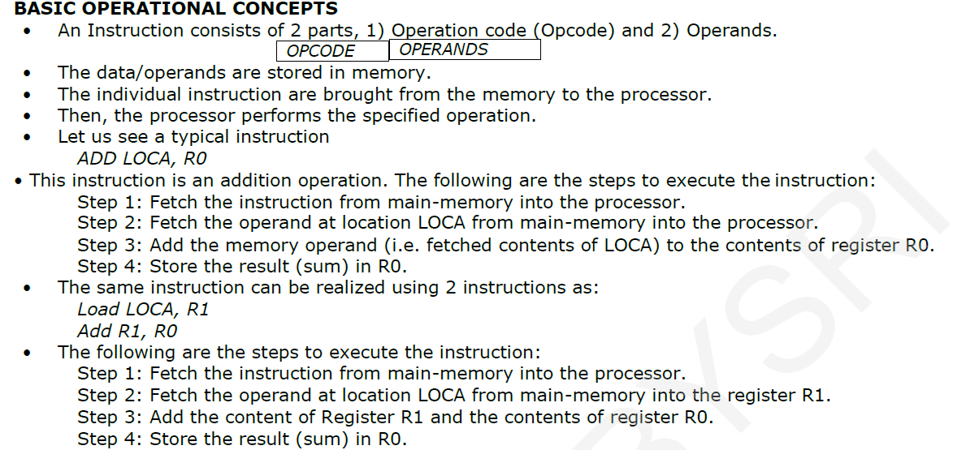

Slide 22
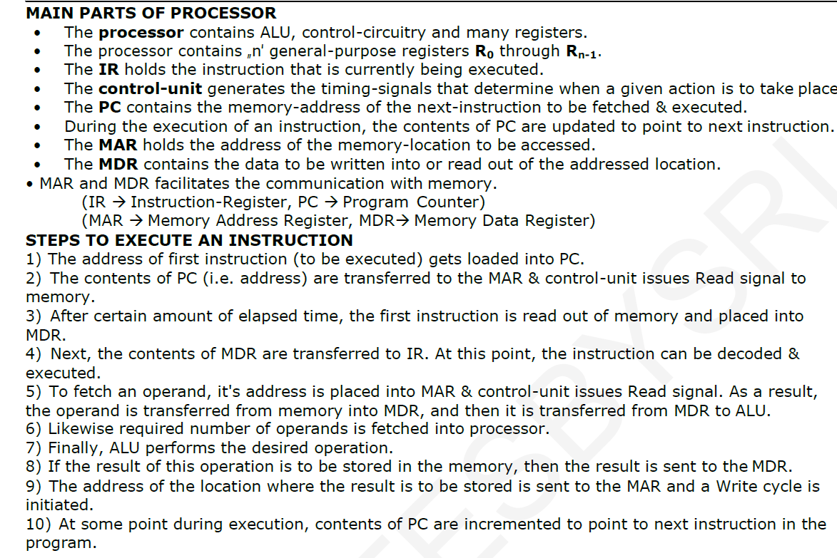

Slide 23
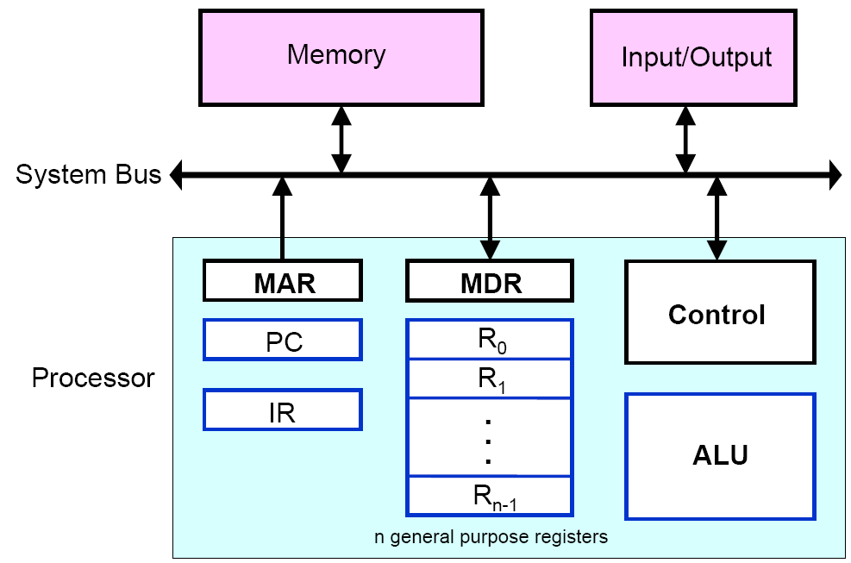
Connection between Processor and Main Memory

Slide 24
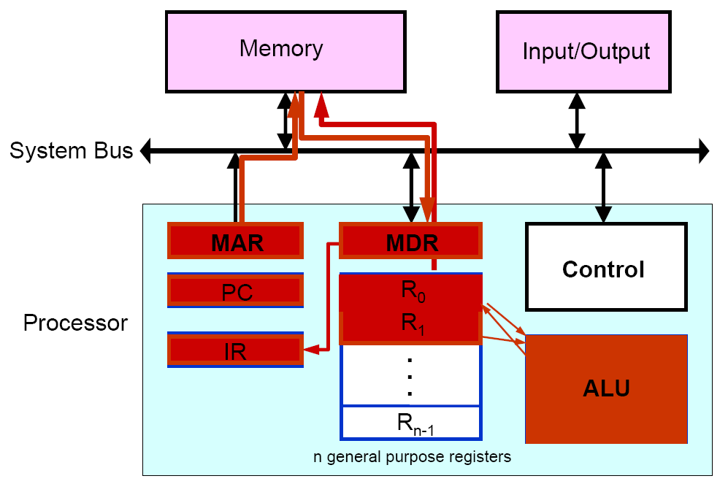
Basic Operational Concepts

Slide 25
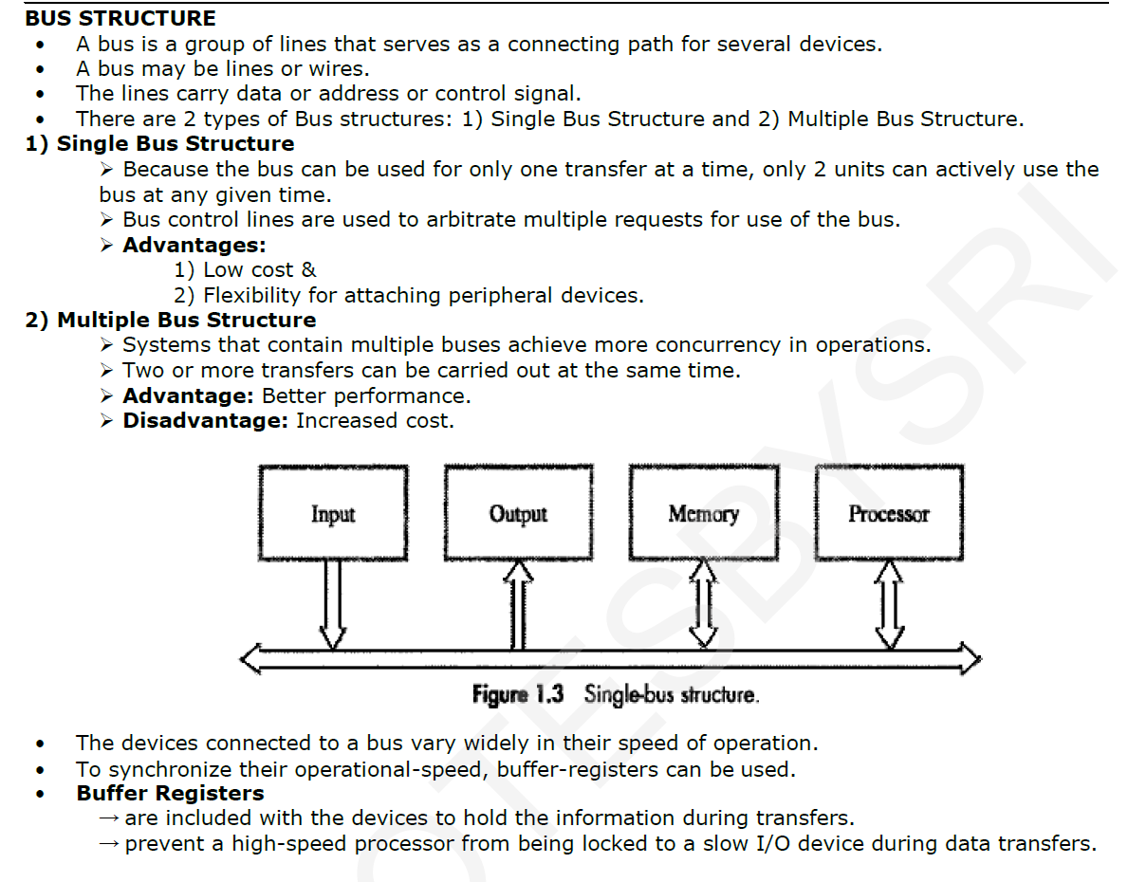

Slide 26
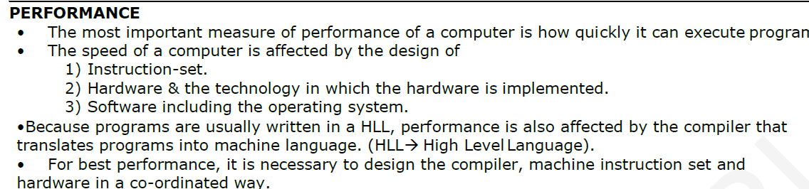

Slide 27
Organization of cache and main memory(Processor cache)
Main
Cache
Processor
memory
memory
Bus
Why is the access time of the cache memory lesser than the
access time of the main memory?

Slide 28
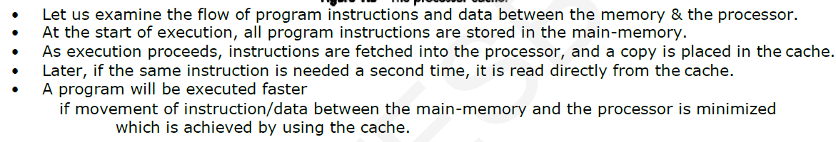

Slide 29
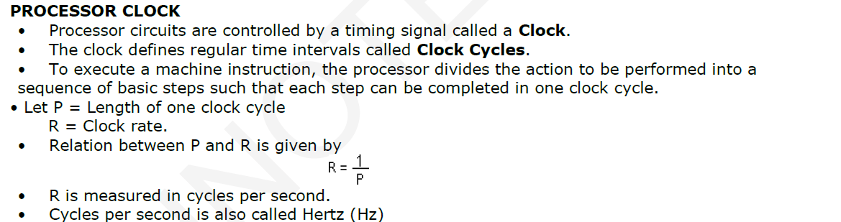

Slide 30
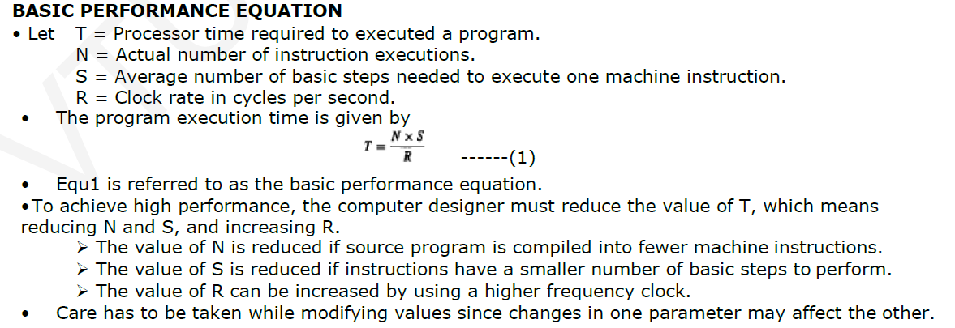

Slide 31
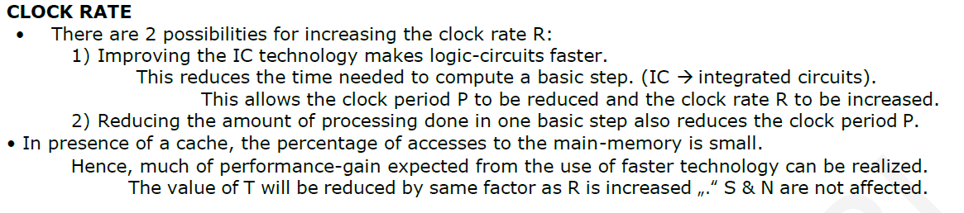

Slide 32
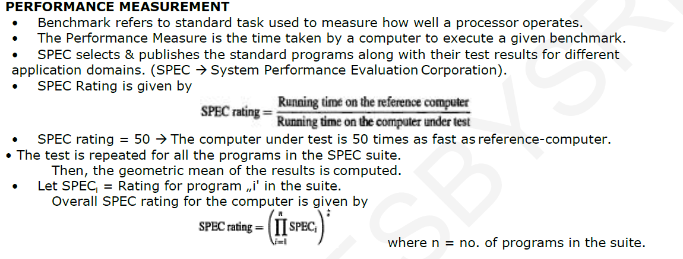

Slide 33
Chapter 2. Machine Instructions and Programs

Slide 34
Objectives
Machine instructions and program execution, including branching and subroutine call and return operations.
Number representation and addition/subtraction in the 2’s-complement system.
Addressing methods for accessing register and memory operands.
Assembly language for representing machine instructions, data, and programs.
Program-controlled Input/Output operations.

Slide 35
Number, Arithmetic Operations, and Characters

Slide 36
Signed Integer
3 major representations:
Sign and magnitude
One’s complement
Two’s complement
Assumptions:
4-bit machine word
16 different values can be represented
Roughly half are positive, half are negative

Slide 37
Sign and Magnitude Representation
High order bit is sign: 0 = positive (or zero), 1 = negative
Three low order bits is the magnitude: 0 (000) thru 7 (111)
Number range for n bits = +/-2^{n-1} -1
Two representations for 0

Slide 38
One’s Complement Representation
Subtraction implemented by addition & 1's complement
Still two representations of 0! This causes some problems
Some complexities in addition

Slide 39
Two’s Complement Representation
like 1's comp
except shifted
one position
clockwise
Only one representation for 0
One more negative number than positive number

Slide 40
Binary, Signed-Integer Representations
Page 28
B
V
alues represented
Sign and
b
3
b
2
b
1
b
0
magnitude
1'
s complement
2'
s complement
0
1
1
1
+
7
+
7
+
7
0
1
1
0
+
6
+
6
+
6
0
1
0
1
+
5
+
5
+
5
0
1
0
0
+
4
+
4
+
4
0
0
1
1
+
3
+
3
+
3
0
0
1
0
+
2
+
2
+
2
0
0
0
1
+
1
+
1
+
1
0
0
0
0
+
0
+
0
+
0
1
0
0
0
-
0
-
7
-
8
1
0
0
1
-
1
-
6
-
7
1
0
1
0
-
2
-
5
-
6
1
0
1
1
-
3
-
4
-
5
1
1
0
0
-
4
-
3
-
4
1
1
0
1
-
5
-
2
-
3
1
1
1
0
-
6
-
1
-
2
1
1
1
1
-
7
-
0
-
1
Figure 2.1. Binary, signed-integer representations.

Slide 41
Addition and Subtraction – 2’s Complement
4
+ 3
7
0100
0011
0111
-4
+ (-3)
-7
1100
1101
11001
If carry-in to the high
order bit =
carry-out then ignore
carry
if carry-in differs from
carry-out then overflow
4
- 3
1
0100
1101
10001
-4
+ 3
-1
1100
0011
1111
Simpler addition scheme makes twos complement the most common
choice for integer number systems within digital systems

Slide 42
2’s-Complement Add and Subtract Operations
(a)
0 0 1 0
(
+
2
)
(b)
0 1 0 0
(
+
4
)
Page 31
+
0 0 1 1
(
+
3
)
+
1 0 1 0
(
-
6
)
0 1 0 1
(
+
5
)
1 1 1 0
(
-
2
)
(c)
1 0 1 1
(
-
5
)
(d)
0 1 1 1
(
+
7
)
+
1 1 1 0
(
-
2
)
+
1 1 0 1
(
-
3
)
1 0 0 1
(
-
7
)
0 1 0 0
(
+
4
)
(e)
1 1 0 1
(
-
3
)
1 1 0 1
-
1 0 0 1
(
-
7
)
+
0 1 1 1
0 1 0 0
(
+
4
)
(f)
0 0 1 0
(
+
2
)
0 0 1 0
-
0 1 0 0
(
+
4
)
+
1 1 0 0
1 1 1 0
(
-
2
)
(g)
0 1 1 0
(
+
6
)
0 1 1 0
-
0 0 1 1
(
+
3
)
+
1 1 0 1
0 0 1 1
(
+
3
)
(h)
1 0 0 1
(
-
7
)
1 0 0 1
-
1 0 1 1
(
-
5
)
+
0 1 0 1
1 1 1 0
(
-
2
)
(i)
1 0 0 1
(
-
7
)
1 0 0 1
-
0 0 0 1
(
+
1
)
+
1 1 1 1
1 0 0 0
(
-
8
)
(j)
0 0 1 0
(
+
2
)
0 0 1 0
-
1 1 0 1
(
-
3
)
+
0 0 1 1
0 1 0 1
(
+
5
)
Figure 2.4. 2's-complement Add and Subtract operations.

Slide 43
Overflow - Add two positive numbers to get a negative number or two negative numbers to get a positive number
-1
+0
-1
+0
-2
1111
0000
+1
-2
1111
0000
+1
-3
1110
0001
-3
1110
0001
1101
+2
1101
+2
-4
0010
-4
0010
1100
0011
+3
1100
0011
+3
-5
1011
-5
0100
+4
1011
0100
+4
-6
1010
-6
1010
0101
+5
0101
+5
1001
0110
1001
0110
-7
1000
+6
-7
+6
0111
1000
0111
-8
+7
-8
+7
5 + 3 = -8
-7 - 2 = +7

Slide 44
Overflow Conditions
0 1 1 1
0 1 0 1
0 0 1 1
1 0 0 0
1 0 0 0
1 0 0 1
1 1 0 0
1 0 1 1 1
5
3
-8
-7
-2
7
Overflow
Overflow
0 0 0 0
0 1 0 1
0 0 1 0
0 1 1 1
1 1 1 1
1 1 0 1
1 0 1 1
1 1 0 0 0
5
2
7
-3
-5
-8
No overflow
No overflow
Overflow when carry-in to the high-order bit does not equal carry out

Slide 45
Sign Extension
Task:
Given w-bit signed integer x
Convert it to w+k-bit integer with same value
Rule:
Make k copies of sign bit:
X ′ = x_{w–1} ,…, x_{w–1} , x_{w–1} , x_{w–2} ,…, x₀
w
X
• • •
k copies of MSB
• • •
X ′
• • •
• • •
k
w

Slide 46
Sign Extension Example
short int x = 15213;
int ix = (int) x;
short int y = -15213;
int iy = (int) y;

Slide 47
Memory Locations, Addresses, and Operations

Slide 48
Memory Location, Addresses, and Operation
n
bits
Memory consists of many millions of storage cells, each of which can store 1 bit.
Data is usually accessed in n-bit groups. n is called word length.
first word
second word
•
•
•
i
th word
•
•
•
last word
Figure 2.5. Memory words.

Slide 49
Memory Location, Addresses, and Operation
32-bit word length example
32 bits
•
•
•
b
31
b
30
b
1
b
0
Sign bit:
b
31
=
0
for positive numbers
b
31
=
1
for negative numbers
(a) A signed integer
8 bits
8 bits
8 bits
8 bits
ASCII
ASCII
ASCII
ASCII
character
character
character
character
(b) Four characters

Slide 50
Memory Location, Addresses, and Operation
To retrieve information from memory, either for one word or one byte (8-bit), addresses for each location are needed.
A k-bit address memory has 2^{k} memory locations, namely 0 – 2^{k}-1, called memory space.
24-bit memory: 2²⁴ = 16,777,216 = 16M (1M=2²⁰)
32-bit memory: 2³² = 4G (1G=2³⁰)
1K(kilo)=2¹⁰
1T(tera)=2⁴⁰

Slide 51
Memory Location, Addresses, and Operation
It is impractical to assign distinct addresses to individual bit locations in the memory.
The most practical assignment is to have successive addresses refer to successive byte locations in the memory – byte-addressable memory.
Byte locations have addresses 0, 1, 2, … If word length is 32 bits, they successive words are located at addresses 0, 4, 8,…

Slide 52
Big-Endian and Little-Endian Assignments
Big-Endian: lower byte addresses are used for the most significant bytes of the word
Little-Endian: opposite ordering. lower byte addresses are used for the less significant bytes of the word
W
ord
address
Byte address
Byte address
0
0
1
2
3
0
3
2
1
0
4
4
5
6
7
4
7
6
5
4
•
•
•
•
•
•
2
k
-
4
2
k
-
4
2
k
-
3
2
k
-
2
2
k
-
1
2
k
-
4
2
k
-
1
2
k
-
2
2
k
-
3
2
k
-
4
(a) Big-endian assignment
(b) Little-endian assignment
Figure 2.7. Byte and word addressing.

Slide 53
Memory Location, Addresses, and Operation
Address ordering of bytes
Word alignment
Words are said to be aligned in memory if they begin at a byte addr. that is a multiple of the num of bytes in a word.
16-bit word: word addresses: 0, 2, 4,….
32-bit word: word addresses: 0, 4, 8,….
64-bit word: word addresses: 0, 8,16,….
Access numbers, characters, and character strings

Slide 54
Memory Operation
Load (or Read or Fetch)
Copy the content. The memory content doesn’t change.
Address – Load
Registers can be used
Store (or Write)
Overwrite the content in memory
Address and Data – Store
Registers can be used

Slide 55
Instruction and Instruction Sequencing

Slide 56
“Must-Perform” Operations
Data transfers between the memory and the processor registers
Arithmetic and logic operations on data
Program sequencing and control
I/O transfers

Slide 57
Register Transfer Notation
Identify a location by a symbolic name standing for its hardware binary address (LOC, R0,…)
Contents of a location are denoted by placing square brackets around the name of the location (R1←[LOC], R3 ←[R1]+[R2])
Register Transfer Notation (RTN)

Slide 58
Assembly Language Notation
Represent machine instructions and programs.
Move LOC, R1 = R1←[LOC]
Add R1, R2, R3 = R3 ←[R1]+[R2]

Slide 59
CPU Organization
Single Accumulator
Result usually goes to the Accumulator
Accumulator has to be saved to memory quite often
General Register
Registers hold operands thus reduce memory traffic
Register bookkeeping
Stack
Operands and result are always in the stack

Slide 60
Instruction Formats
Three-Address Instructions
ADD R1, R2, R3 R1 ← R2 + R3
Two-Address Instructions
ADD R1, R2 R1 ← R1 + R2
One-Address Instructions
ADD M AC ← AC + M[AR]
Zero-Address Instructions
ADD TOS ← TOS + (TOS – 1)
Instruction
Opcode
Operand(s) or Address(es)

Slide 61
Instruction Formats
Example: Evaluate (A+B) ∗ (C+D)
Three-Address
ADD R1, A, B ; R1 ← M[A] + M[B]
ADD R2, C, D ; R2 ← M[C] + M[D]
MUL X, R1, R2 ; M[X] ← R1 ∗ R2

Slide 62
Instruction Formats
Example: Evaluate (A+B) ∗ (C+D)
Two-Address
MOV R1, A ; R1 ← M[A]
ADD R1, B ; R1 ← R1 + M[B]
MOV R2, C ; R2 ← M[C]
ADD R2, D ; R2 ← R2 + M[D]
MUL R1, R2 ; R1 ← R1 ∗ R2
MOV X, R1 ; M[X] ← R1

Slide 63
Instruction Formats
Example: Evaluate (A+B) ∗ (C+D)
One-Address
LOAD A ; AC ← M[A]
ADD B ; AC ← AC + M[B]
STORE T ; M[T] ← AC
LOAD C ; AC ← M[C]
ADD D ; AC ← AC + M[D]
MUL T ; AC ← AC ∗ M[T]
STORE X ; M[X] ← AC

Slide 64
Instruction Formats
Example: Evaluate (A+B) ∗ (C+D)
Zero-Address
PUSH A ; TOS ← A
PUSH B ; TOS ← B
ADD ; TOS ← (A + B)
PUSH C ; TOS ← C
PUSH D ; TOS ← D
ADD ; TOS ← (C + D)
MUL ; TOS ← (C+D)∗(A+B)
POP X ; M[X] ← TOS

Slide 65
Using Registers
Registers are faster
Shorter instructions
The number of registers is smaller (e.g. 32 registers need 5 bits)
Potential speedup
Minimize the frequency with which data is moved back and forth between the memory and processor registers.

Slide 66
Instruction Execution and Straight-Line Sequencing
Address
Contents
Assumptions:
- One memory operand
per instruction
- 32-bit word length
- Memory is byte
addressable
- Full memory address
can be directly specified
in a single-word instruction
Begin execution here
i
Move
A,R0
3-instruction
i
+ 4
Add
B,R0
program
segment
i
+ 8
Move
R0,C
A
B
Data for
the program
Two-phase procedure
Instruction fetch
Instruction execute
C
Page 43
Figure 2.8. A program for C ← [Α] + [Β].

Slide 67
i
Move
NUM1,R0
i
+
4
Add
NUM2,R0
i
+
8
Add
NUM3,R0
•
•
•
i
+
4
n
-
4
Add
NUM
n
,R0
i
+
4
n
Move
R0,SUM
•
•
•
SUM
NUM1
NUM2
•
•
•
NUM
n
Figure 2.9. A straight-line program for adding n numbers.

Slide 68
Branching
Move
N,R1
Clear
R0
LOOP
Determine address of
"Next" number and add
Program
"Next" number to R0
loop
Decrement
R1
Branch target
Branch>0
LOOP
Move
R0,SUM
Conditional branch
•
•
•
SUM
N
n
NUM1
Figure 2.10. Using a loop to add n numbers.
NUM2
•
•
•
NUM
n

Slide 69
Condition Codes
Condition code flags
Condition code register / status register
N (negative)
Z (zero)
V (overflow)
C (carry)
Different instructions affect different flags

Slide 70
Addressing Modes

Slide 71
Generating Memory Addresses
How to specify the address of branch target?
Can we give the memory operand address directly in a single Add instruction in the loop?
Use a register to hold the address of NUM1; then increment by 4 on each pass through the loop.

Slide 72
Addressing Modes
Implied
AC is implied in “ADD M[AR]” in “One-Address” instr.
TOS is implied in “ADD” in “Zero-Address” instr.
Immediate
The use of a constant in “MOV R1, 5”, i.e. R1 ← 5
Register
Indicate which register holds the operand
Instruction
Opcode
Mode
...

Slide 73
Addressing Modes
Register Indirect
Indicate the register that holds the number of the register that holds the operand
MOV R1, (R2)
Autoincrement / Autodecrement
Access & update in 1 instr.
Direct Address
Use the given address to access a memory location
R1
R2 = 3
R3 = 5

Slide 74
Addressing Modes
Indirect Address
Indicate the memory location that holds the address of the memory location that holds the data
Memory
AR = 101
100
101
0 1 0 4
102
103
104
1 1 0 A

Slide 75
Addressing Modes
Memory
Relative Address
EA = PC + Relative Addr
0
1
Program
PC = 2
2
+
100
Data
AR = 100
101
102
1 1 0 A
Could be Positive or Negative (2’s Complement)
103
104

Slide 76
Addressing Modes
Indexed
EA = Index Register + Relative Addr
Memory
Useful with “Autoincrement” or “Autodecrement”
XR = 2
+
100
AR = 100
101
Could be Positive or Negative (2’s Complement)
102
1 1 0 A
103
104

Slide 77
Addressing Modes
Base Register
EA = Base Register + Relative Addr
Memory
Could be Positive or Negative (2’s Complement)
AR = 2
+
100
0 0 0 5
BR = 100
101
0 0 1 2
102
0 0 0 A
Usually points to the beginning of an array
103
0 1 0 7
104
0 0 5 9

Slide 78
Addressing Modes
Name
Assem
bler
syn
tax
Addressing
function
The different ways in which the location of an operand is specified in an instruction are referred to as addressing modes.
Immediate
#V
alue
Op
erand
=
V
alue
Register
R
i
EA
=
R
i
Absolute
(Direct)
LOC
EA
=
LOC
Indirect
(R
i
)
EA
=
[R
i
]
(LOC)
EA
=
[LOC]
Index
X(R
i
)
EA
=
[R
i
]
+
X
Base
with
index
(R
i
,R
j
)
EA
=
[R
i
]
+
[R
j
]
Base
with
index
X(R
i
,R
j
)
EA
=
[R
i
]
+
[R
j
]
+
X
and
offset
Relative
X(PC)
EA
=
[PC]
+
X
Autoincremen
t
(R
i
)+
EA
=
[R
i
]
;
Incremen
t
R
i
Autodecrement
−
(R
i
)
Decremen
t
R
i
;
EA
=
[R
i
]

Slide 79
Indexing and Arrays
Index mode – the effective address of the operand is generated by adding a constant value to the contents of a register.
Index register
X(R_{i}): EA = X + [R_{i}]
The constant X may be given either as an explicit number or as a symbolic name representing a numerical value.
If X is shorter than a word, sign-extension is needed.

Slide 80
Indexing and Arrays
In general, the Index mode facilitates access to an operand whose location is defined relative to a reference point within the data structure in which the operand appears.
Several variations: (R_{i}, R_{j}): EA = [R_{i}] + [R_{j}] X(R_{i}, R_{j}): EA = X + [R_{i}] + [R_{j}]

Slide 81
Relative Addressing
Relative mode – the effective address is determined by the Index mode using the program counter in place of the general-purpose register.
X(PC) – note that X is a signed number
Branch>0 LOOP
This location is computed by specifying it as an offset from the current value of PC.
Branch target may be either before or after the branch instruction, the offset is given as a singed num.

Slide 82
Additional Modes
Autoincrement mode – the effective address of the operand is the contents of a register specified in the instruction. After accessing the operand, the contents of this register are automatically incremented to point to the next item in a list.
(R_{i})+. The increment is 1 for byte-sized operands, 2 for 16-bit operands, and 4 for 32-bit operands.
Autodecrement mode: -(R_{i}) – decrement first
Move
N,R1
Move
#NUM1,R2
Initialization
Clear
R0
LOOP
Add
(R2)+,R0
Decrement
R1
Branch>0
LOOP
Move
R0,SUM
Figure 2.16. The Autoincrement addressing mode used in the program of Figure 2.12.

Slide 83
Assembly Language

Slide 84
Types of Instructions
Data Transfer Instructions
Name | Mnemonic
Load | LD
Store | ST
Move | MOV
Exchange | XCH
Input | IN
Output | OUT
Push | PUSH
Pop | POP
Data value is not modified

Slide 85
Data Transfer Instructions
Mode | Assembly | Register Transfer
Direct address | LD ADR | AC ← M[ADR]
Indirect address | LD @ADR | AC ← M[M[ADR]]
Relative address | LD $ADR | AC ← M[PC+ADR]
Immediate operand | LD #NBR | AC ← NBR
Index addressing | LD ADR(X) | AC ← M[ADR+XR]
Register | LD R1 | AC ← R1
Register indirect | LD (R1) | AC ← M[R1]
Autoincrement | LD (R1)+ | AC ← M[R1], R1 ← R1+1

Slide 86
Data Manipulation Instructions
Arithmetic
Logical & Bit Manipulation
Shift
Name | Mnemonic
Increment | INC
Decrement | DEC
Add | ADD
Subtract | SUB
Multiply | MUL
Divide | DIV
Add with carry | ADDC
Subtract with borrow | SUBB
Negate | NEG
Name | Mnemonic
Clear | CLR
Complement | COM
AND | AND
OR | OR
Exclusive-OR | XOR
Clear carry | CLRC
Set carry | SETC
Complement carry | COMC
Enable interrupt | EI
Disable interrupt | DI
Name | Mnemonic
Logical shift right | SHR
Logical shift left | SHL
Arithmetic shift right | SHRA
Arithmetic shift left | SHLA
Rotate right | ROR
Rotate left | ROL
Rotate right through carry | RORC
Rotate left through carry | ROLC

Slide 87
Program Control Instructions
Name | Mnemonic
Branch | BR
Jump | JMP
Skip | SKP
Call | CALL
Return | RET
Compare (Subtract) | CMP
Test (AND) | TST
Subtract A – B but don’t store the result
1
0
1
1
0
0
0
1
0
0
0
0
1
0
0
0
Mask
0
0
0
0
0
0
0
0

Slide 88
Conditional Branch Instructions
Mnemonic | Branch Condition | Tested Condition
BZ | Branch if zero | Z = 1
BNZ | Branch if not zero | Z = 0
BC | Branch if carry | C = 1
BNC | Branch if no carry | C = 0
BP | Branch if plus | S = 0
BM | Branch if minus | S = 1
BV | Branch if overflow | V = 1
BNV | Branch if no overflow | V = 0

Slide 89
Basic Input/Output Operations

Slide 90
I/O
The data on which the instructions operate are not necessarily already stored in memory.
Data need to be transferred between processor and outside world (disk, keyboard, etc.)
I/O operations are essential, the way they are performed can have a significant effect on the performance of the computer.

Slide 91
Program-Controlled I/O Example
Read in character input from a keyboard and produce character output on a display screen.
Rate of data transfer (keyboard, display, processor)
Difference in speed between processor and I/O device creates the need for mechanisms to synchronize the transfer of data.
A solution: on output, the processor sends the first character and then waits for a signal from the display that the character has been received. It then sends the second character. Input is sent from the keyboard in a similar way.

Slide 92
Program-Controlled I/O Example
- Registers
Flags
- Device interface

Slide 93
Program-Controlled I/O Example
Machine instructions that can check the state of the status flags and transfer data: READWAIT Branch to READWAIT if SIN = 0 Input from DATAIN to R1 WRITEWAIT Branch to WRITEWAIT if SOUT = 0 Output from R1 to DATAOUT

Slide 94
Program-Controlled I/O Example
Memory-Mapped I/O – some memory address values are used to refer to peripheral device buffer registers. No special instructions are needed. Also use device status registers. READWAIT Testbit #3, INSTATUS Branch=0 READWAIT MoveByte DATAIN, R1

Slide 95
Program-Controlled I/O Example
Assumption – the initial state of SIN is 0 and the initial state of SOUT is 1.
Any drawback of this mechanism in terms of efficiency?
Two wait loops→processor execution time is wasted
Alternate solution?
Interrupt

Slide 96
Stacks

Slide 97
Home Work
For each Addressing modes mentioned before, state one example for each addressing mode stating the specific benefit for using such addressing mode for such an application.

Slide 98
Stack Organization
DR
Current Top of Stack TOS
LIFO
Last In First Out
0
1
2
3
4
5
SP
6
0 1 2 3
7
0 0 5 5
FULL
EMPTY
8
0 0 0 8
9
0 0 2 5
Stack Bottom
10
0 0 1 5
Stack

Slide 99
Stack Organization
DR
Current Top of Stack TOS
Current Top of Stack TOS
1 6 9 0
PUSH
SP ← SP – 1
M[SP] ← DR
If (SP = 0) then (FULL ← 1)
EMPTY ← 0
0
1
2
3
4
5
1 6 9 0
SP
6
0 1 2 3
7
0 0 5 5
FULL
EMPTY
8
0 0 0 8
9
0 0 2 5
Stack Bottom
10
0 0 1 5
Stack

Slide 100
Stack Organization
DR
Current Top of Stack TOS
Current Top of Stack TOS
POP
DR ← M[SP]
SP ← SP + 1
If (SP = 11) then (EMPTY ← 1)
FULL ← 0
0
1
2
3
4
5
1 6 9 0
1 6 9 0
SP
6
0 1 2 3
7
0 0 5 5
FULL
EMPTY
8
0 0 0 8
9
0 0 2 5
Stack Bottom
10
0 0 1 5
Stack

Slide 101
Stack Organization
Memory Stack
PUSH
SP ← SP – 1
M[SP] ← DR
POP
DR ← M[SP]
SP ← SP + 1
Memory
PC
0
1
Program
2
AR
100
101
Data
102
200
SP
201
Stack
202

Slide 102
Reverse Polish Notation
Infix Notation
A + B
Prefix or Polish Notation
+ A B
Postfix or Reverse Polish Notation (RPN)
A B +
(2) (4) ∗ (3) (3) ∗ +
(8) (3) (3) ∗ +
(8) (9) +
17
RPN
A ∗ B + C ∗ D
A B ∗ C D ∗ +

Slide 103
Reverse Polish Notation
Example
(A + B) ∗ [C ∗ (D + E) + F]
(A B +)
(D E +)
C ∗
F +
∗

Slide 104
Reverse Polish Notation
Stack Operation
(3) (4) ∗ (5) (6) ∗ +
PUSH 3
PUSH 4
MULT
PUSH 5
PUSH 6
MULT
ADD
6
4
5
30
3
12
42

Slide 105
Additional Instructions

Slide 106
Logical Shifts
Logical shift – shifting left (LShiftL) and shifting right (LShiftR)
C
R0
0
before:
0
0
1
1
1
0
.
.
.
0
1
1
after:
1
1
1
0
.
.
.
0
1
1
0
0
(a) Logical shift left
LShiftL #2,R0
0
R0
C
before:
0
1
1
1
0
.
.
.
0
1
1
0
after:
0
0
0
1
1
1
0
.
.
.
0
1
(b) Logical shift r
ight
LShiftR #2,R0

Slide 107
Arithmetic Shifts
R0
C
before:
1
0
0
1
1
.
.
.
0
1
0
0
after:
1
1
1
0
0
1
1
.
.
.
0
1
(c) Ar
ithmetic shift r
ight
AShiftR #2,R0

Slide 108
Rotate
C
R0
before:
0
0
1
1
1
0
.
.
.
0
1
1
after:
1
1
1
0
.
.
.
0
1
1
0
1
(a) Rotate left without carr
y
RotateL #2,R0
C
R0
before:
0
0
1
1
1
0
.
.
.
0
1
1
after:
1
1
1
0
.
.
.
0
1
1
0
0
(b) Rotate left with carr
y
RotateLC #2,R0
R0
C
before:
0
1
1
1
0
.
.
.
0
1
1
0
after:
1
1
0
1
1
1
0
.
.
.
0
1
(c) Rotate r
ight without carr
y
RotateR #2,R0
R0
C
before:
0
1
1
1
0
.
.
.
0
1
1
0
after:
1
0
0
1
1
1
0
.
.
.
0
1
(d) Rotate r
ight with carr
y
RotateRC #2,R0
Figure 2.32. Rotate instructions.

Slide 109
Multiplication and Division
Not very popular (especially division)
Multiply R_{i}, R_{j} R_{j} ← [R_{i}] х [R_{j}]
2n-bit product case: high-order half in R(j+1)
Divide R_{i}, R_{j} R_{j} ← [R_{i}] / [R_{j}]
Quotient is in Rj, remainder may be placed in R(j+1)

Slide 110
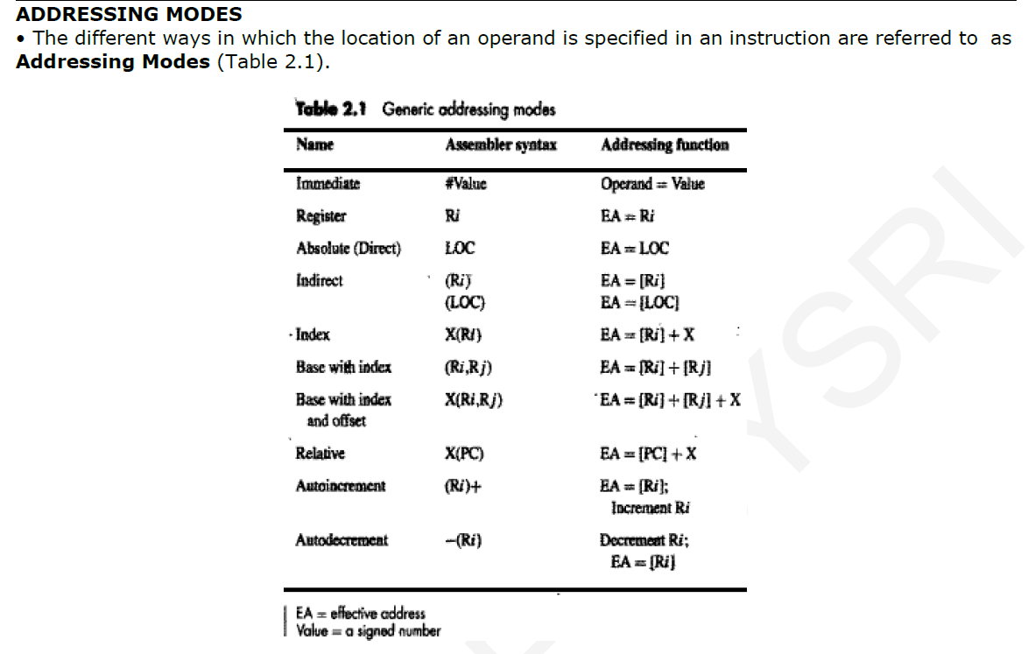

Slide 111
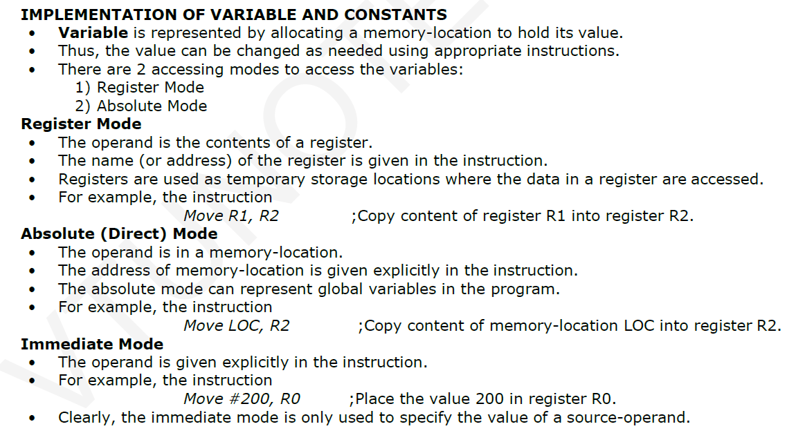

Slide 112
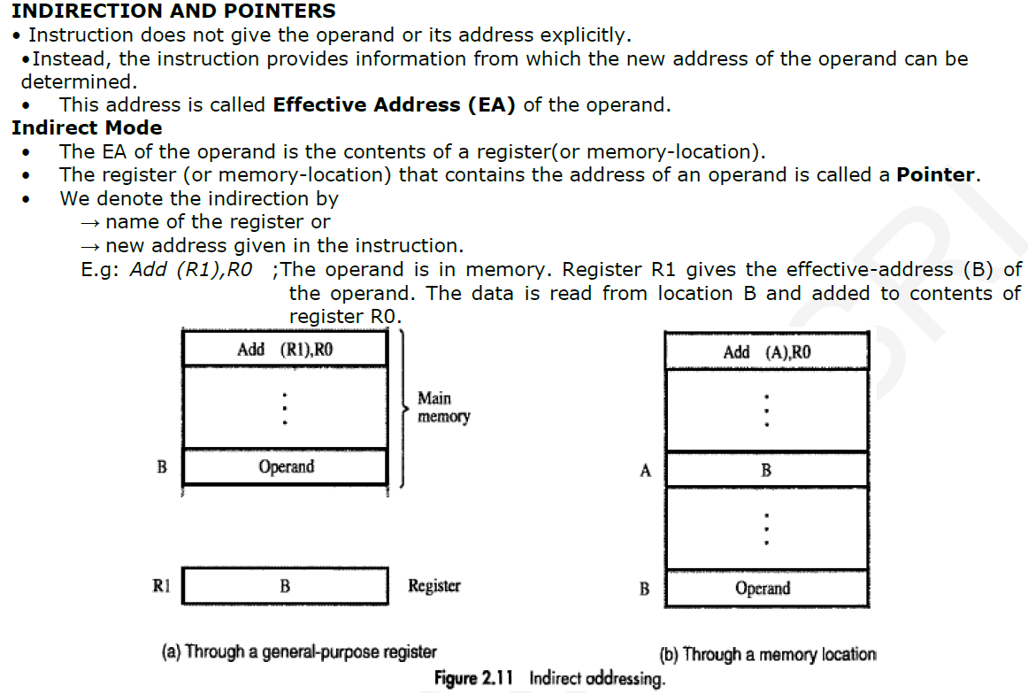

Slide 113
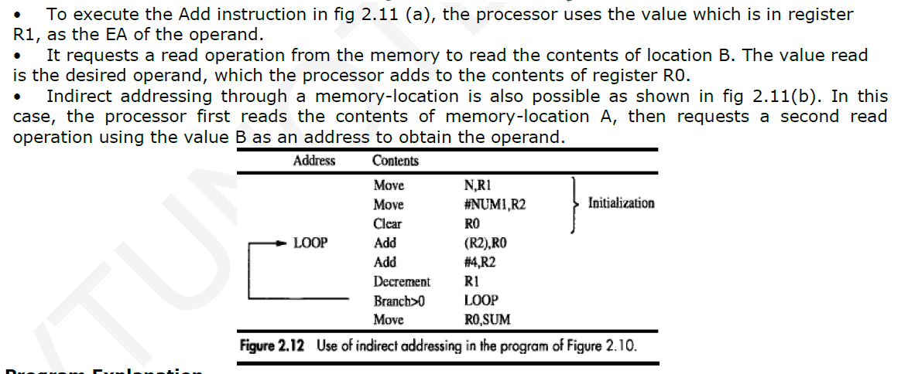

Slide 114
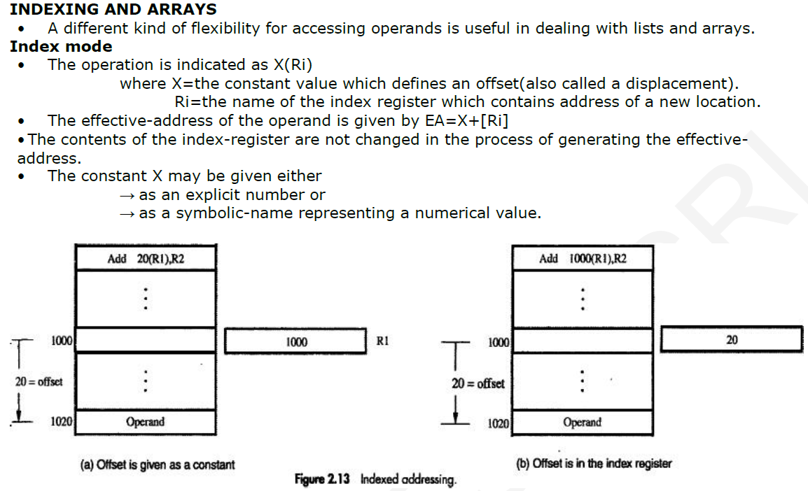

Slide 115
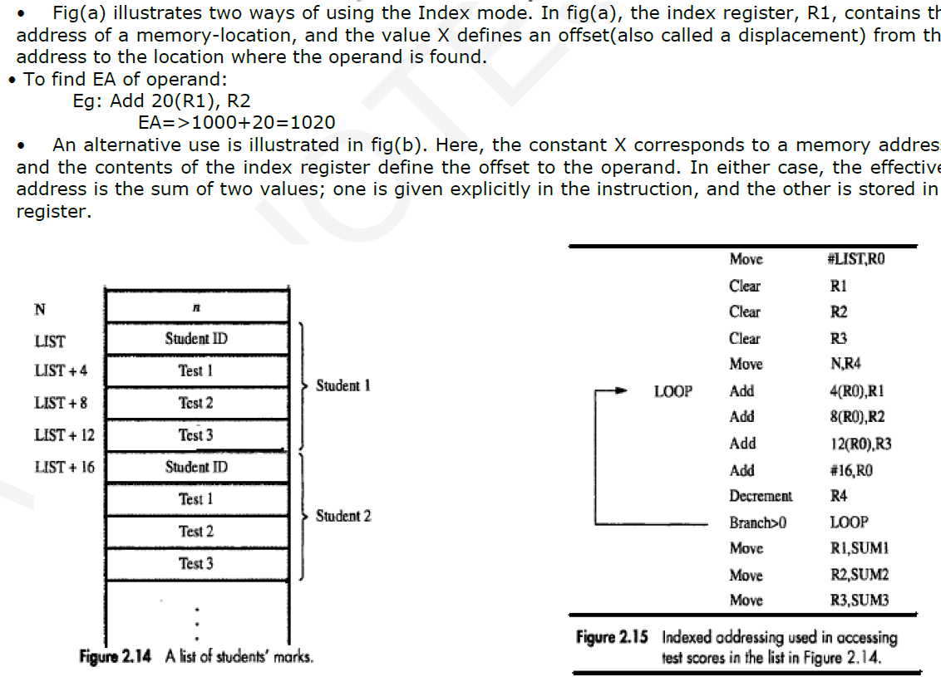

Slide 116
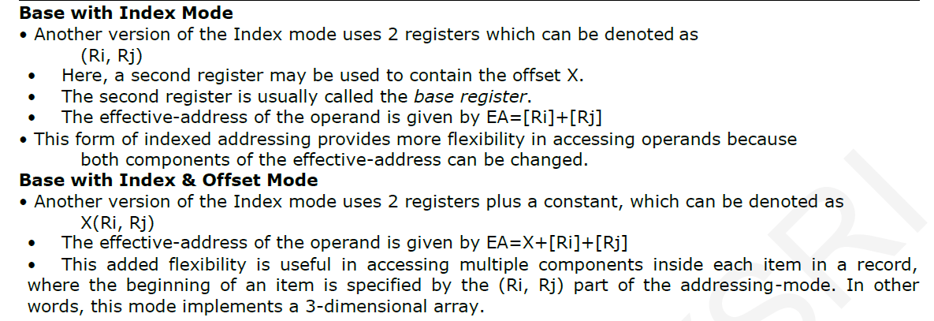

Slide 117
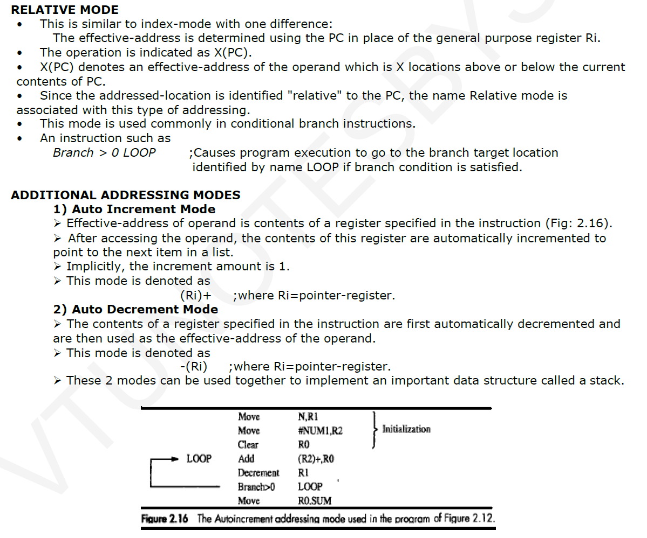

Slide 118
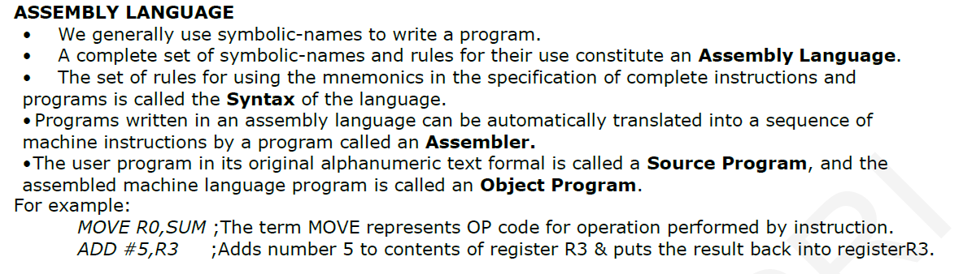

Slide 119
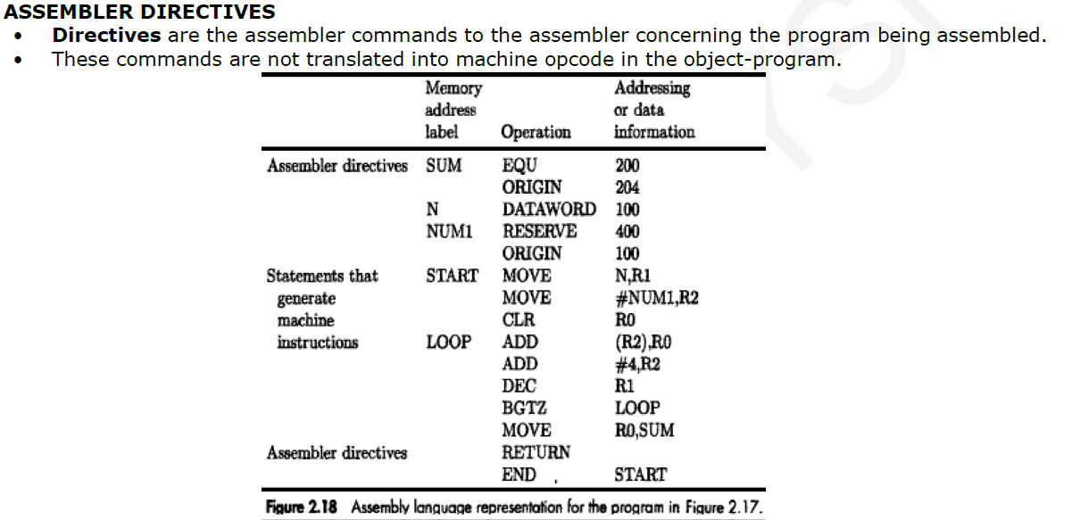

Slide 120
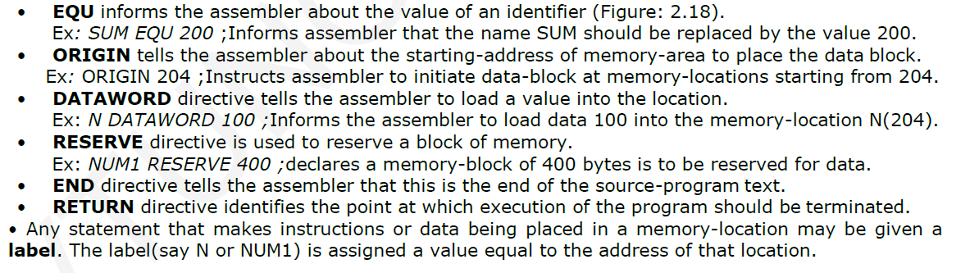

Slide 121
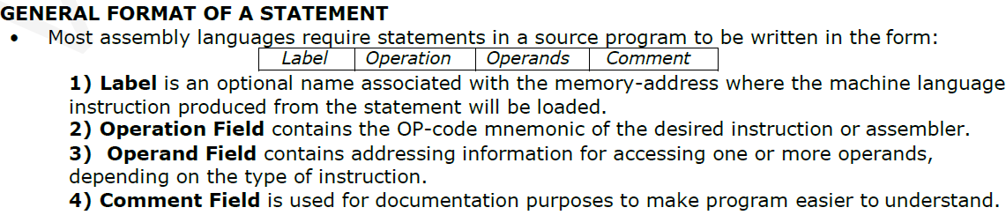

Slide 122
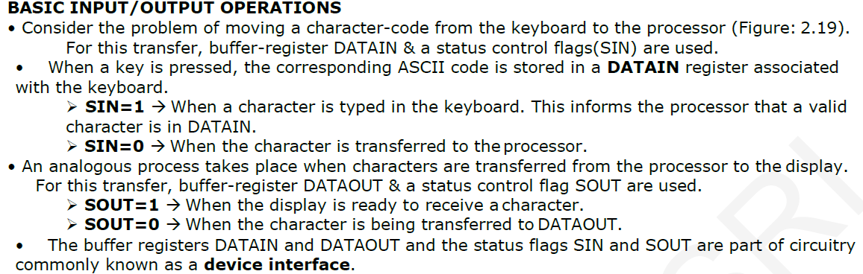

Slide 123
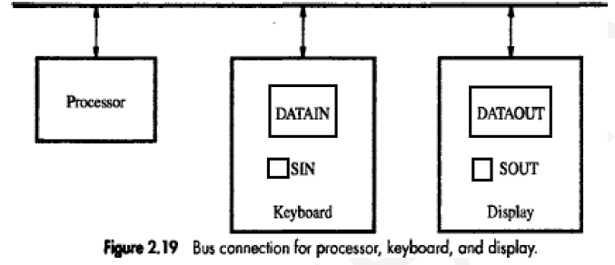

Slide 124
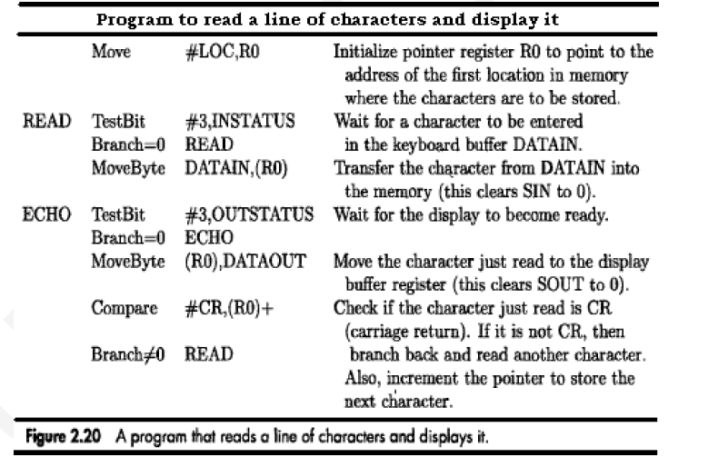

Slide 125
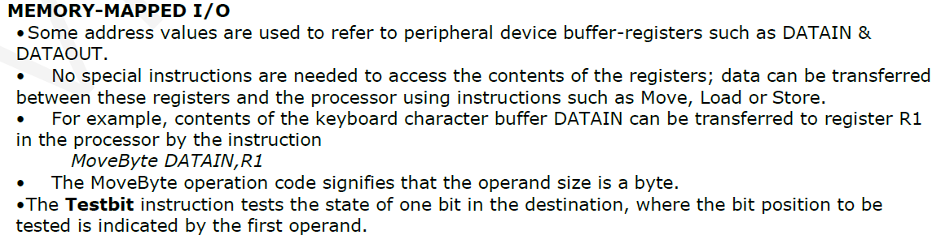

Slide 126
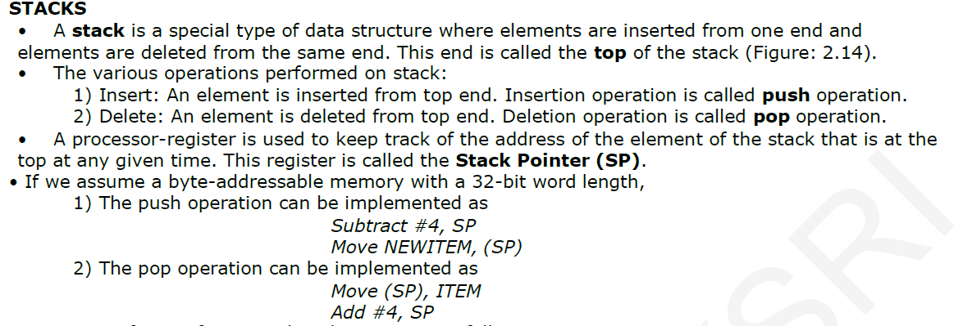

Slide 127
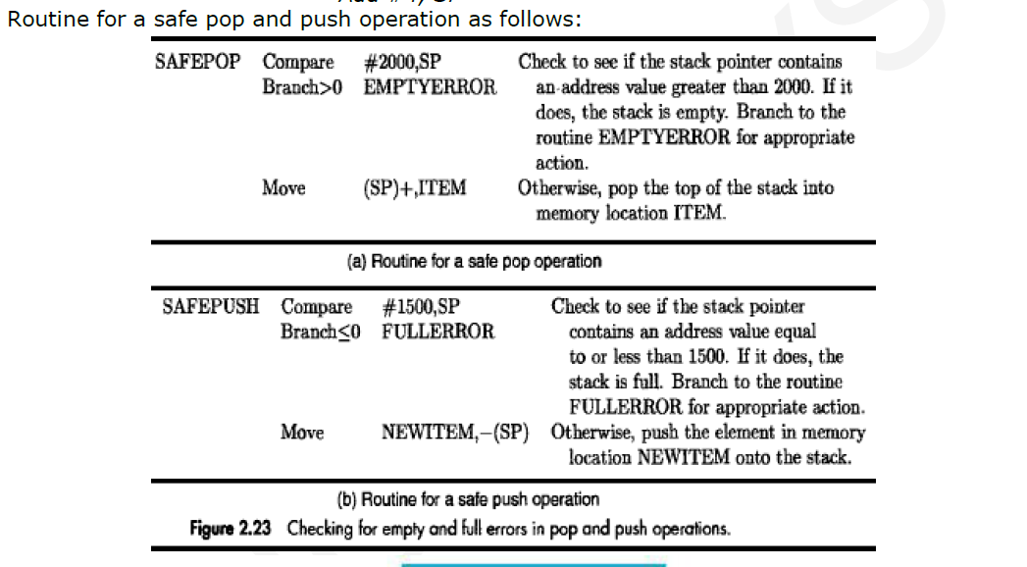

Slide 128
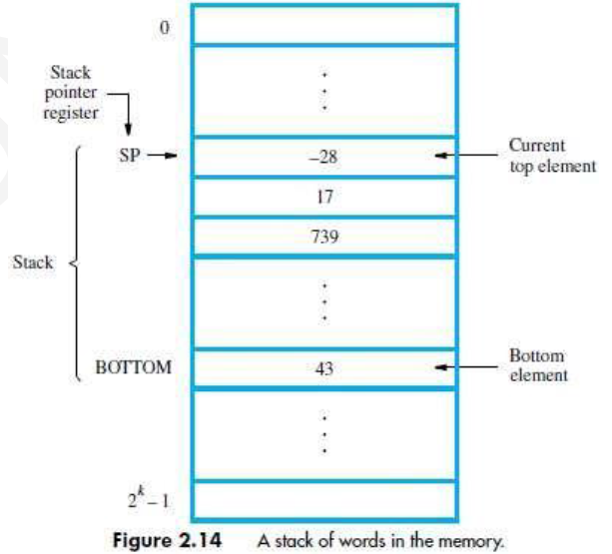

Slide 129
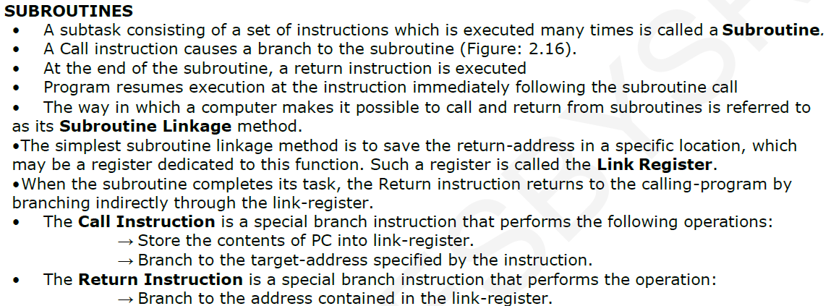

Slide 130
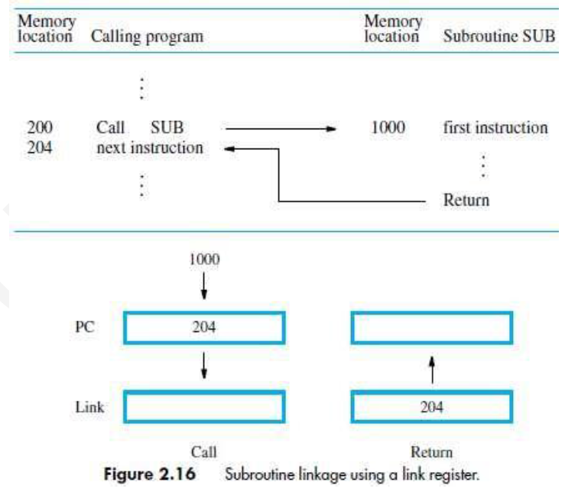

Slide 131
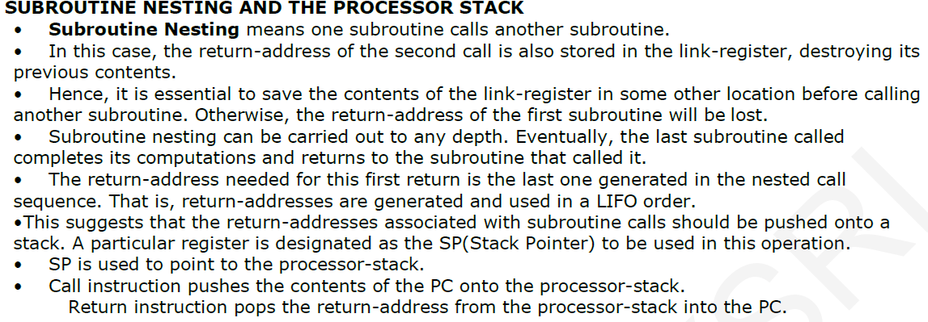

Slide 132
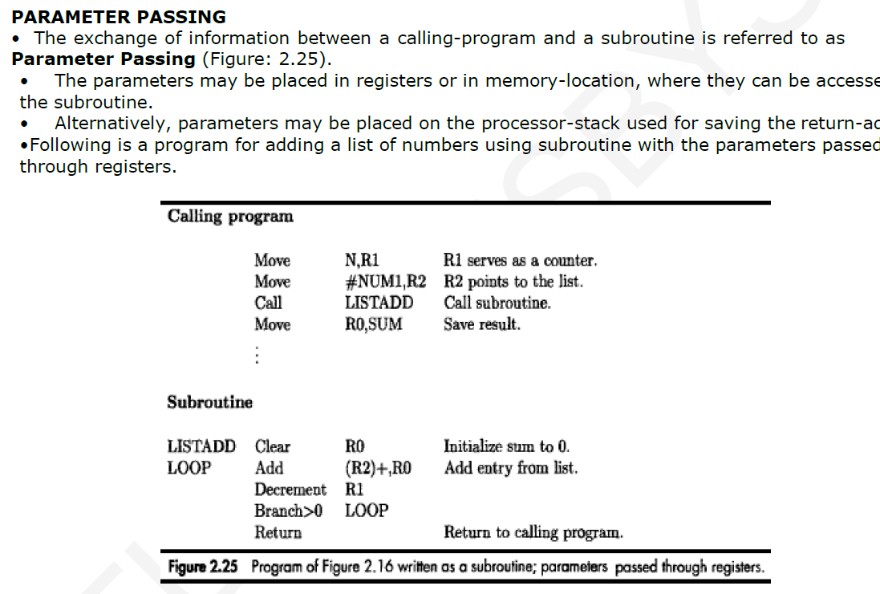

Slide 133
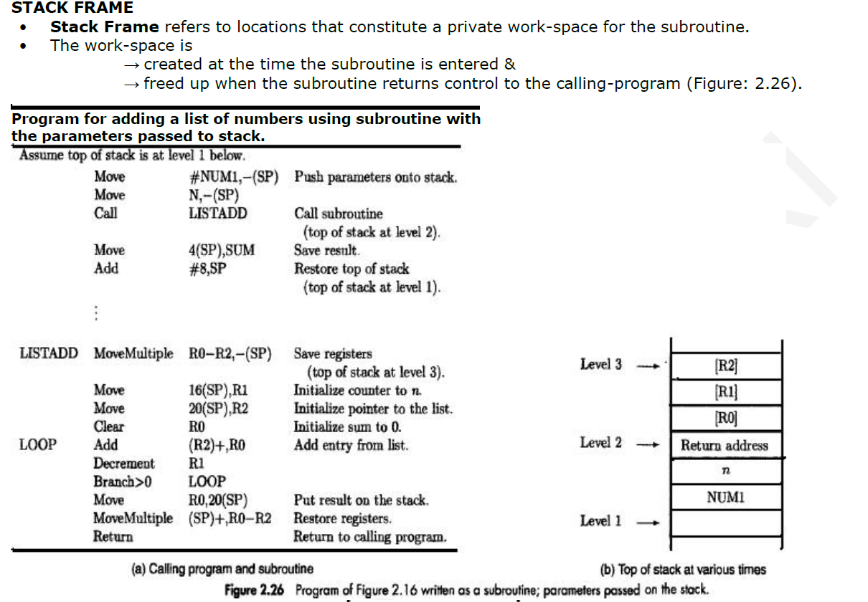

Slide 134
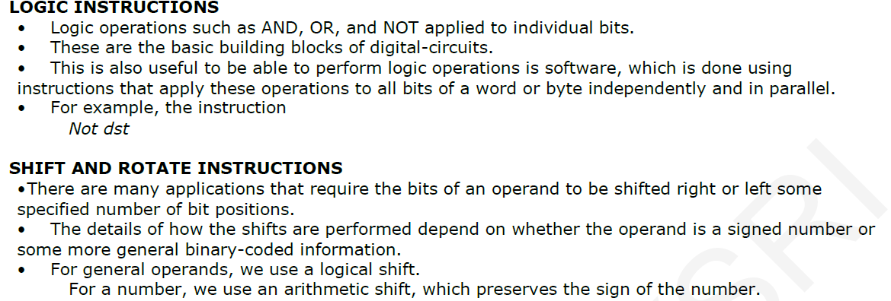
Additional Instructions

Slide 135
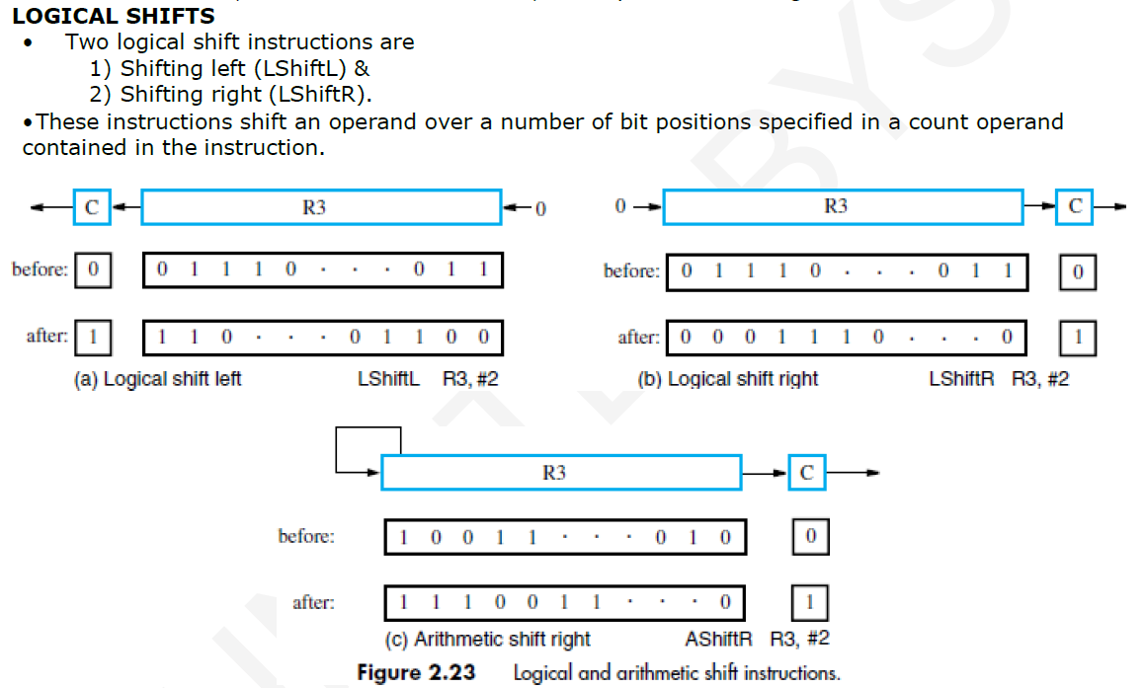

Slide 136
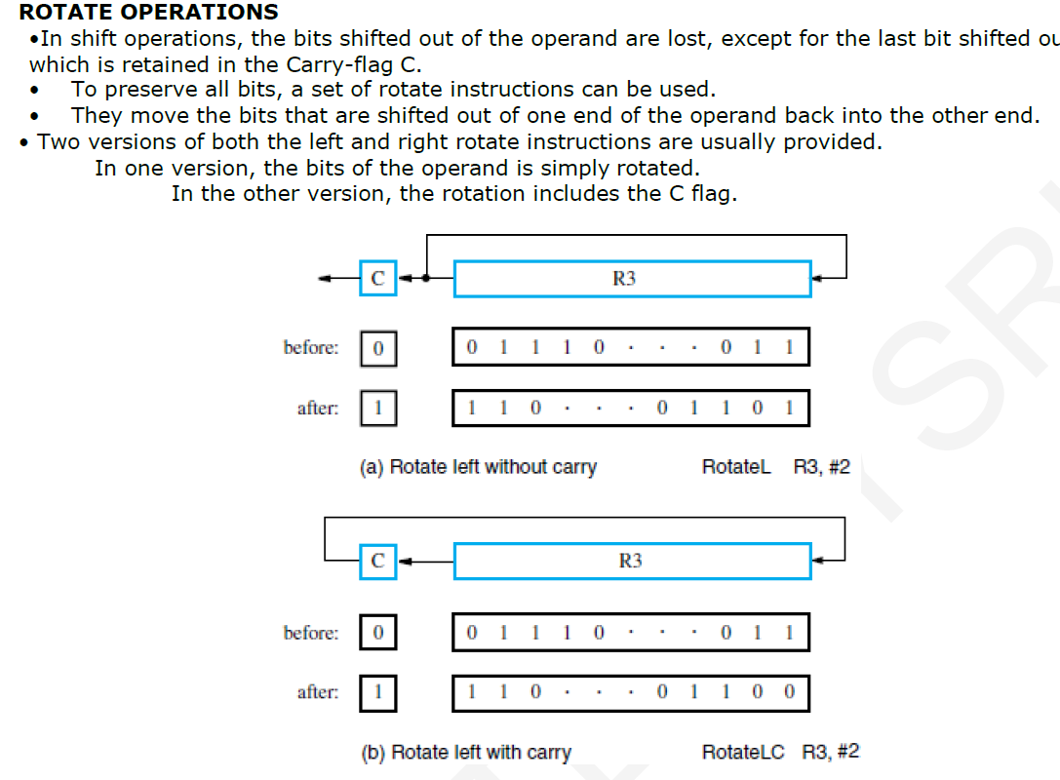

Slide 137
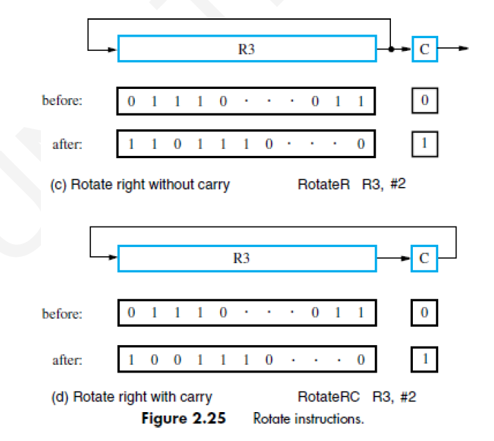

Slide 138
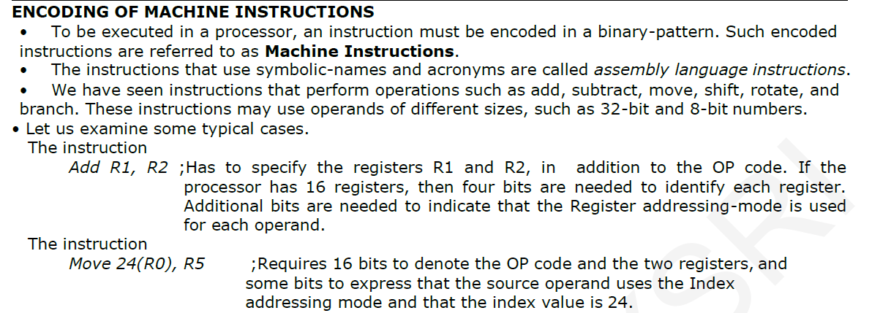

Slide 139
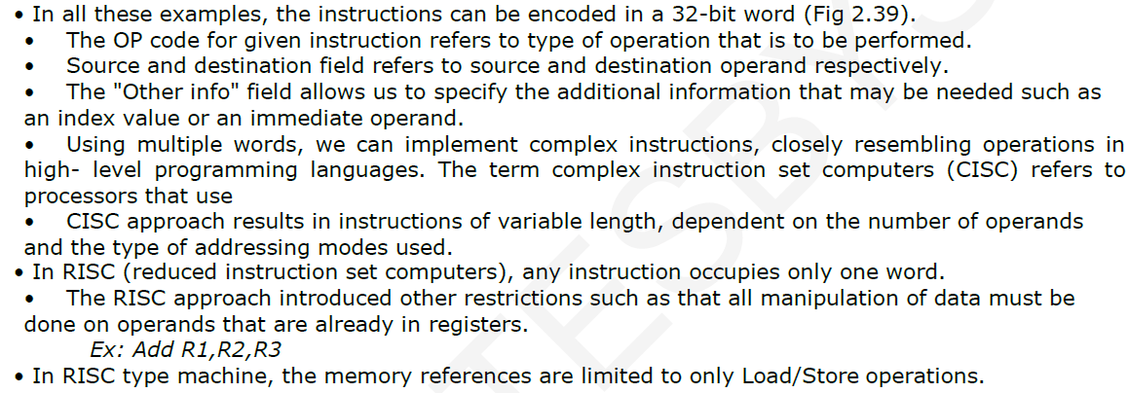

Slide 140
